Slide 1
Program Name goes here
Link to github Repository: GitHub
Links to trello board / project management tools: Trello Board
You MUST provide evidence showing how the problem has been decomposed, how the components have been developed and trialled, and of how they have been assembled and tested to create a final, working outcome.

Slide 2
Relevant Implications
Explain the relevant implications here. Please watch this video to learn how to do this.
Notes:
Explain the relevant implications here. Then as you work, develop your code, discuss how the implications are being met.

Slide 3
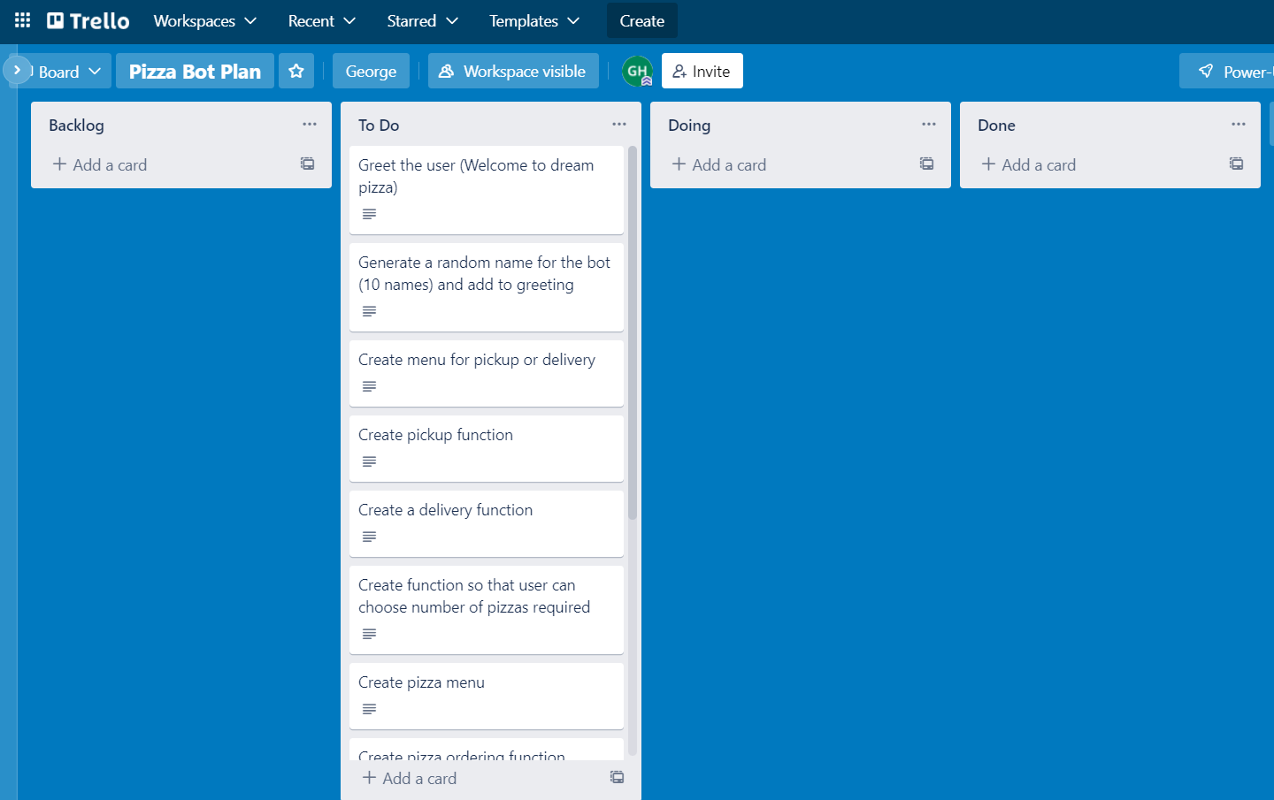
Decomposition
Notes:
Paste screenshots of your initial Trello board / task decomposition on this slide. If you have a long list, you might need to break it up into several columns. Delete this instruction when you are done.

Slide 4
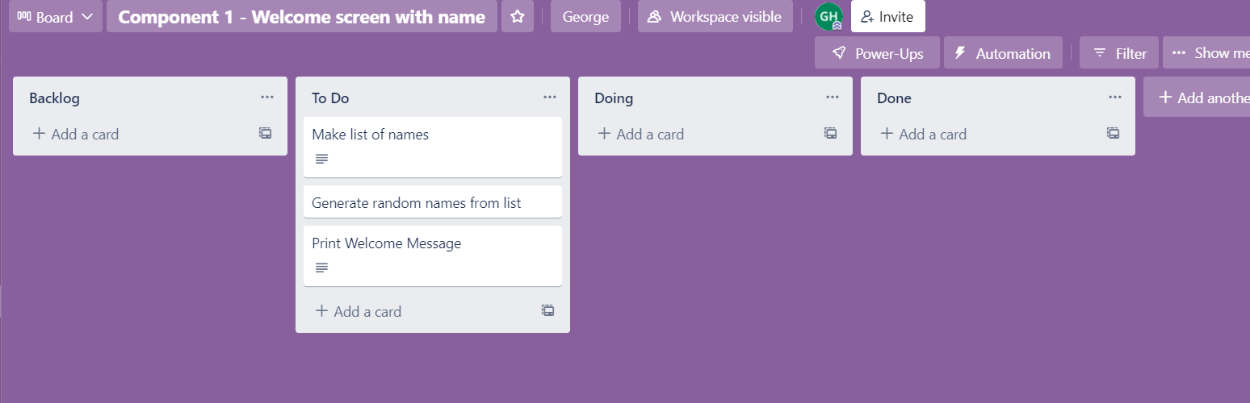
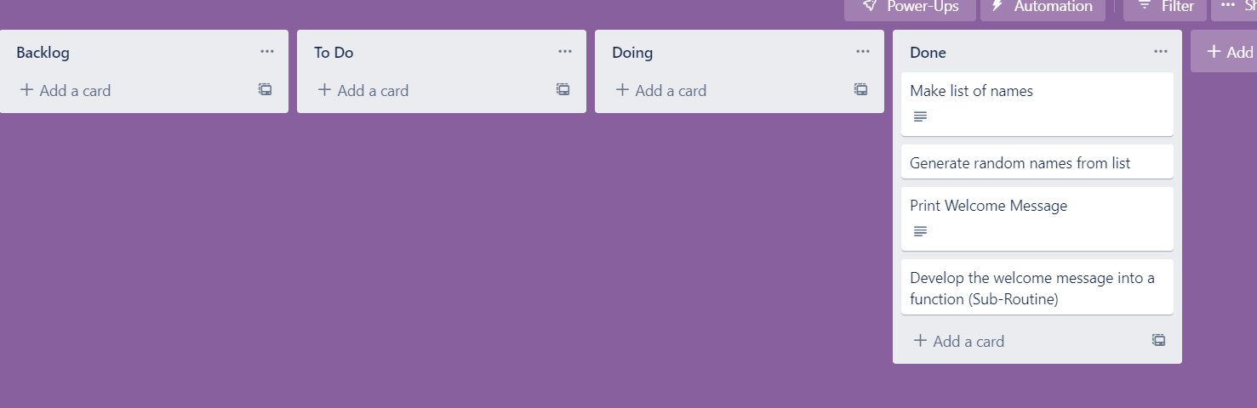
Component 1 (Trello screenshot)
Version 1
Version 2

Slide 5
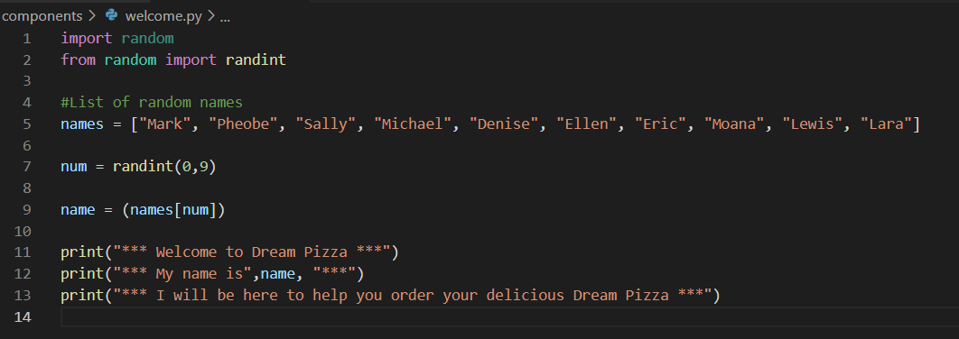
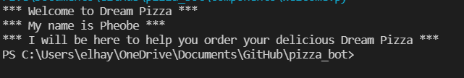
Component 1 - Test Plan (?and screenshot)
Test Case | Expected Values
Run program | Print welcome message with random name from list of names – Runs correctly

Slide 6
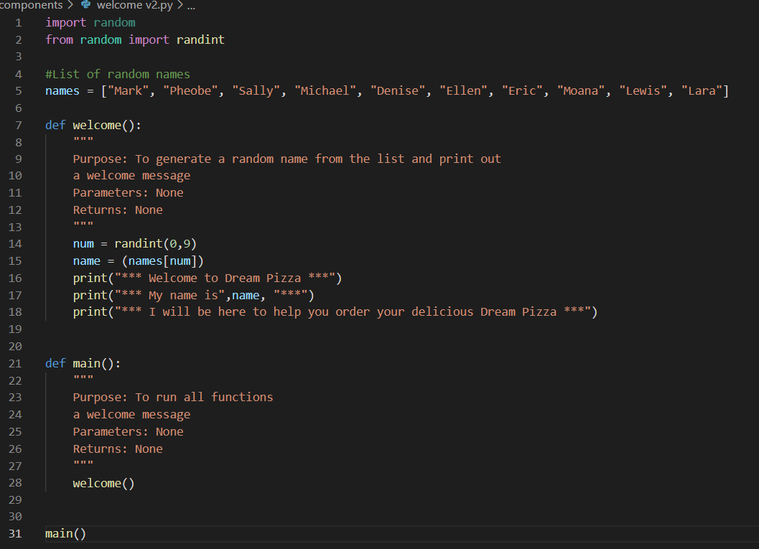
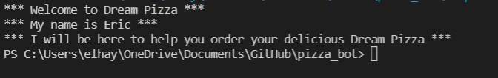
Component 1 version 2 - Test Plan (?and screenshot)
Test Case | Expected Values
Run program | Main and welcome correctly. Welcome message prints with random name

Slide 7
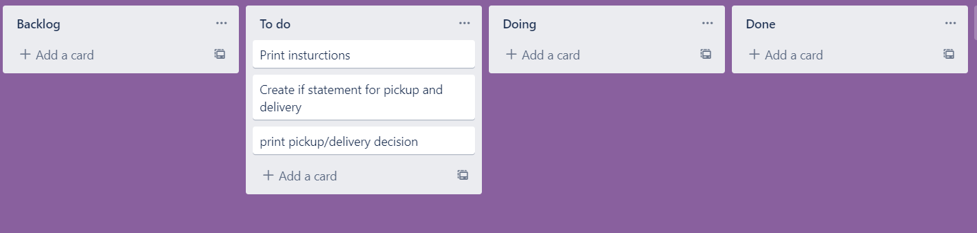
Component 2 (Trello screenshot)

Slide 8
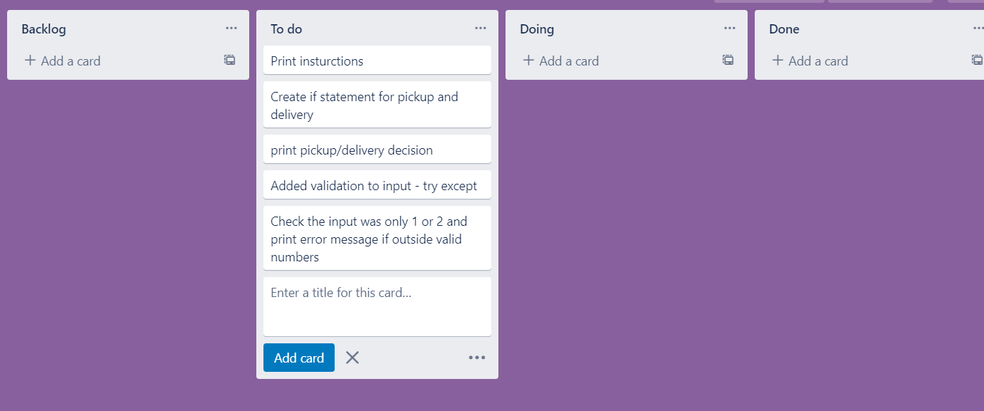
Component 2 (Trello screenshot)

Slide 9
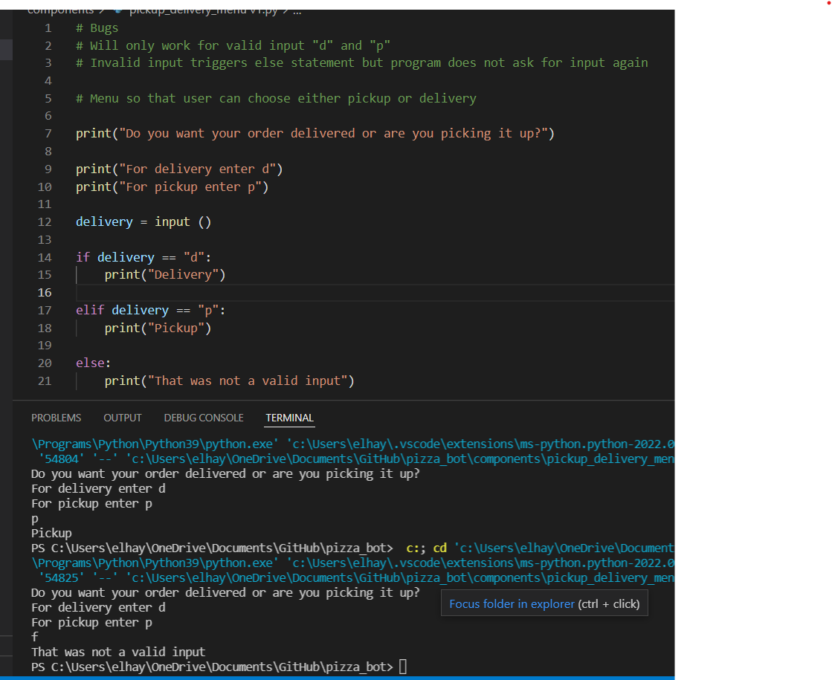
Component 2 version 1 - Test Plan (?and screenshot)
Test Case | Expected Values
Run program | Enter d program prints delivery Enter p program prints pickup Enter invalid program prints error message

Slide 10
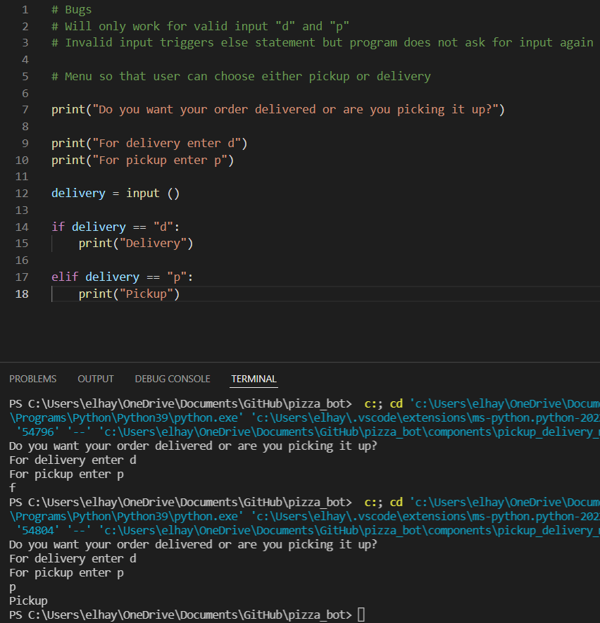
Component 2 version 2 - Test Plan (?and screenshot)
Test Case | Expected Values
Run program | Enter d program prints delivery Enter p program prints pickup Enter invalid program prints nothing

Slide 11
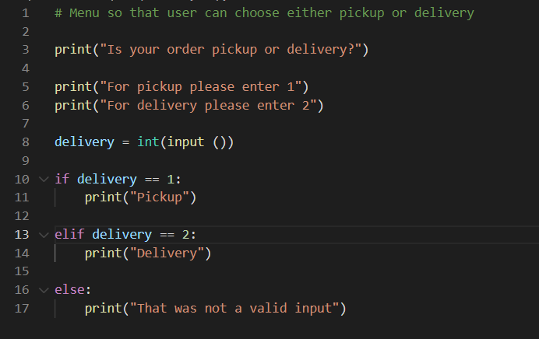
Component 2 version 3 - Test Plan (?and screenshot)
Test Case | Expected Values
Run program | Enter 1 program prints pickup Enter 2 program prints delivery Enter invalid program displays value error

Slide 12
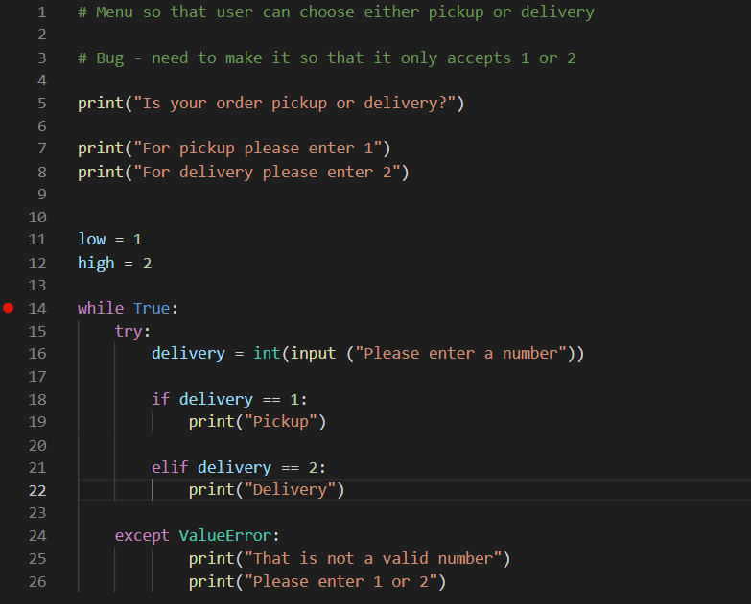
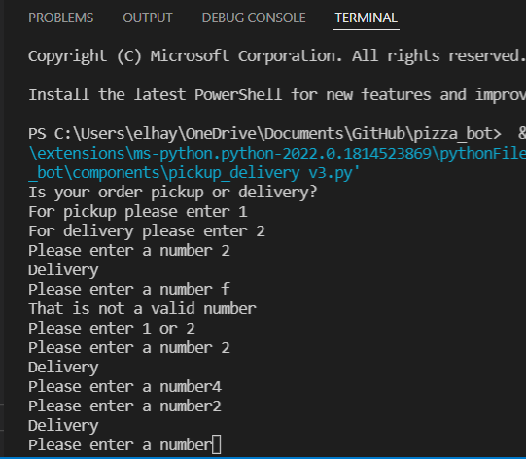
Component 2 version 4 - Test Plan (?and screenshot)
Test Case | Expected Values
Run program | Enter 1 program prints pickup Enter 2 program prints delivery Enter invalid program displays value error Enter number other than 1 or 2 does not work

Slide 13
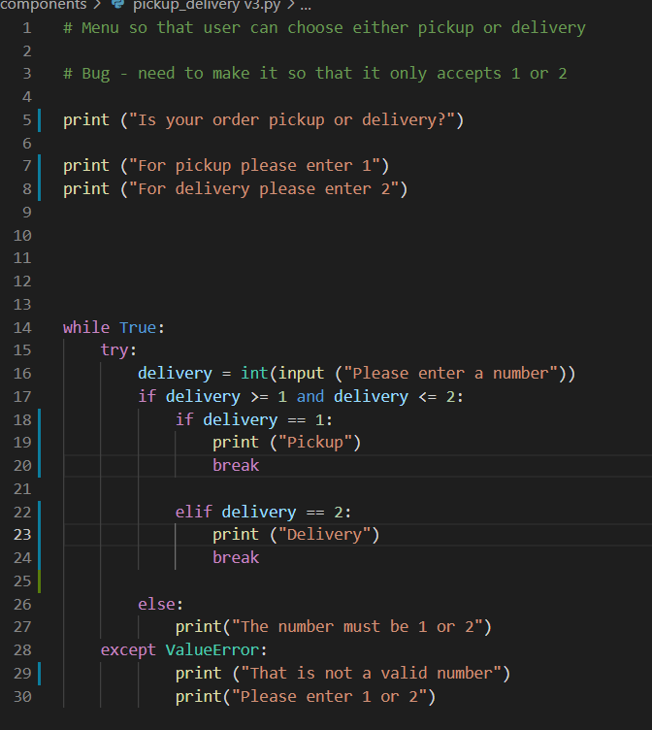
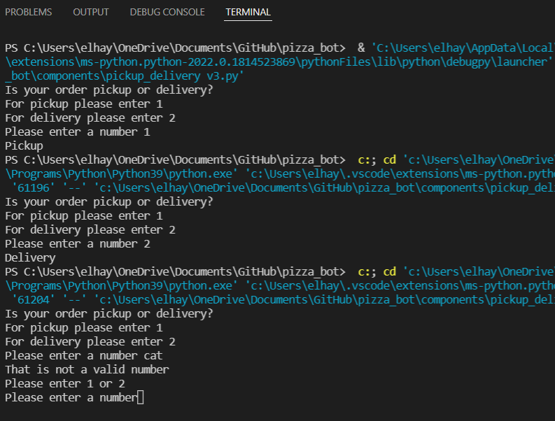
Component 2 version 5 - Test Plan (?and screenshot)
Test Case | Expected Values
Run program | Enter 1 program prints pickup Enter 2 program prints delivery Enter invalid entry – error message asks for input again Enter number other than 1 or 2 – error message asks for entry again

Slide 14
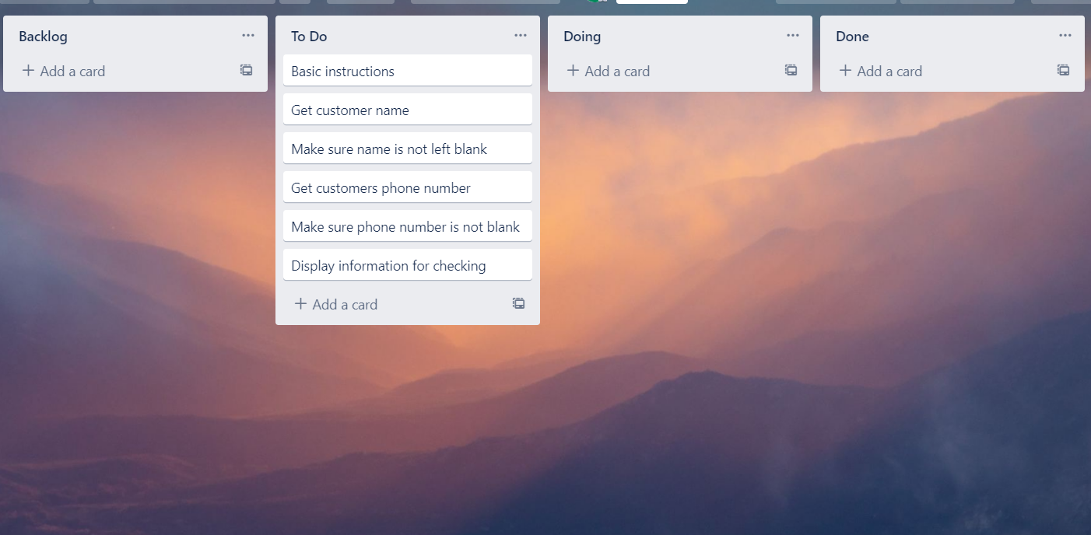
Component 3 Pickup info (Trello screenshot)

Slide 15
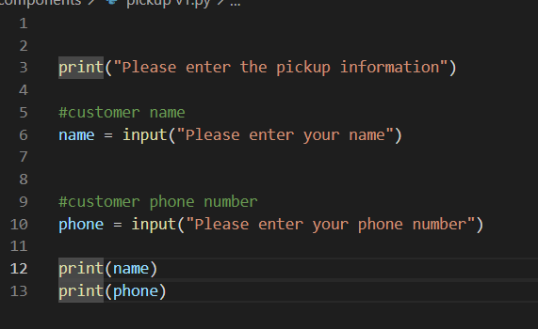
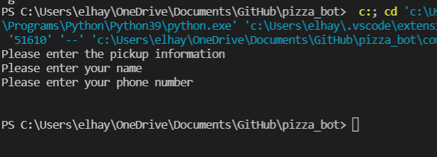
Component 3 Version 1 - Test Plan (?and screenshot)
Test Case | Expected Values
Input name Input phone number Left input blank | Printed name correctly Printed phone number Accepted blank and printed blank input

Slide 16
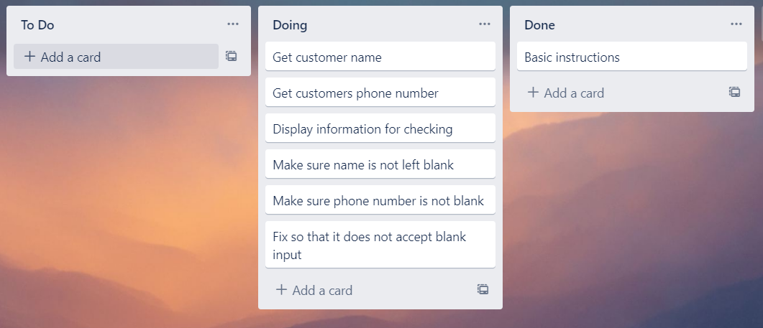
Component 3 Pickup info v2 (Trello screenshot)

Slide 17
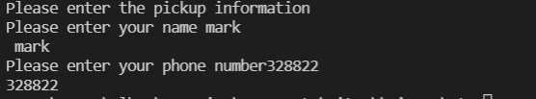
Component 3 Version 2 - Test Plan (?and screenshot)
Test Case | Expected Values
Input name Input phone number Left input blank | Printed name correctly Printed phone number Prints “Sorry this cannot be bank – goes back to input

Slide 18
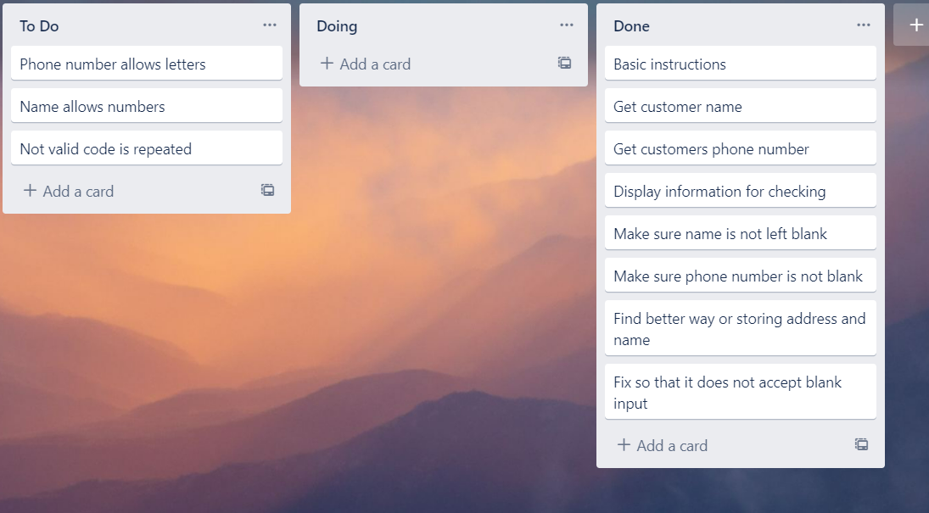
Component 3 Pickup info v3 (Trello screenshot)

Slide 19
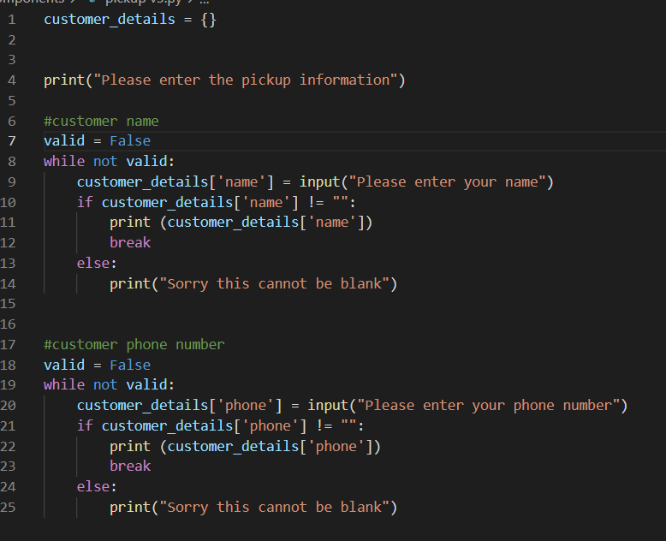
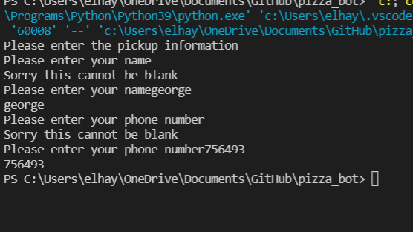
Component 3 Version 3 - Test Plan (?and screenshot)
Test Case | Expected Values
Input name Input phone number Left input blank | Printed name correctly Printed phone number Prints “Sorry this cannot be bank – goes back to input

Slide 20
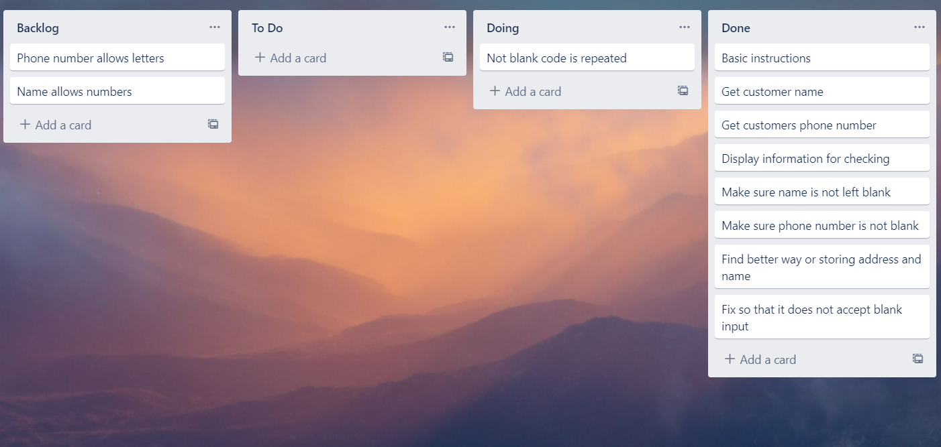
Component 3 Pickup info v4 (Trello screenshot)

Slide 21
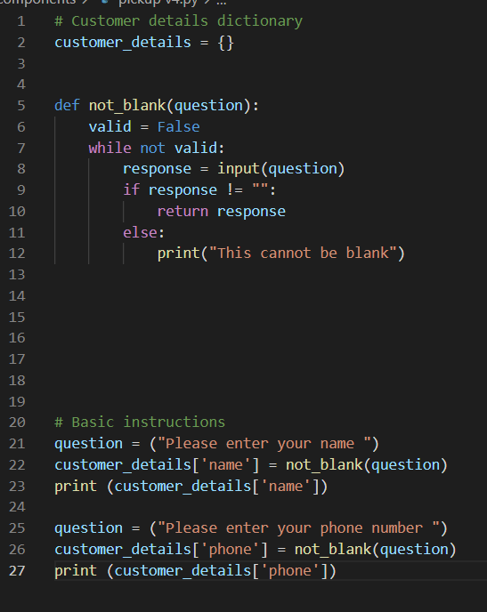
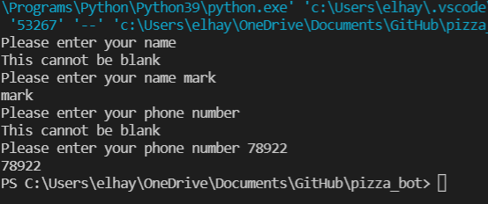
Component 3 v4 - Test Plan (?and screenshot)
Test Case | Expected Values
Input name Input phone number Left input blank | Printed name correctly Printed phone number Prints “Sorry this cannot be bank – goes back to input

Slide 22
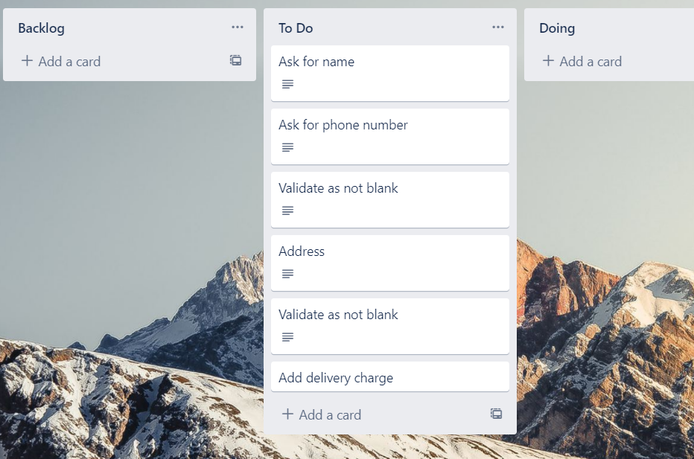
Component 4 delivery info v1 (Trello screenshot)

Slide 23
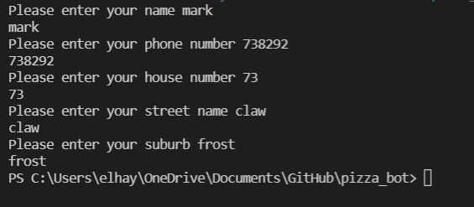
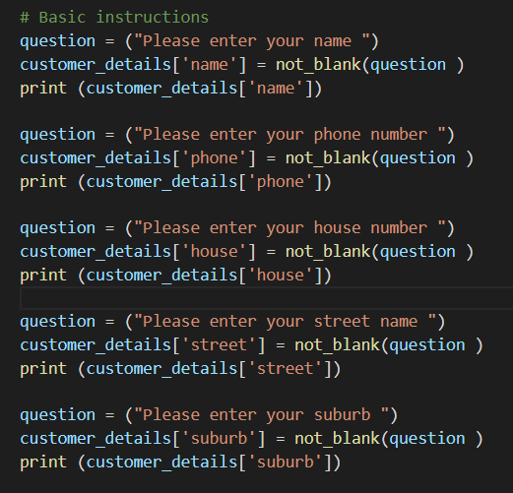
Component 4 v1 - Test Plan (?and screenshot)
Test Case | Expected Values
Input name Input phone number Input house number Street name Suburb name Left input blank | Printed name correctly Printed phone number Accepted blank and printed blank input Printed street name Printed suburb name Asked for input again

Slide 24
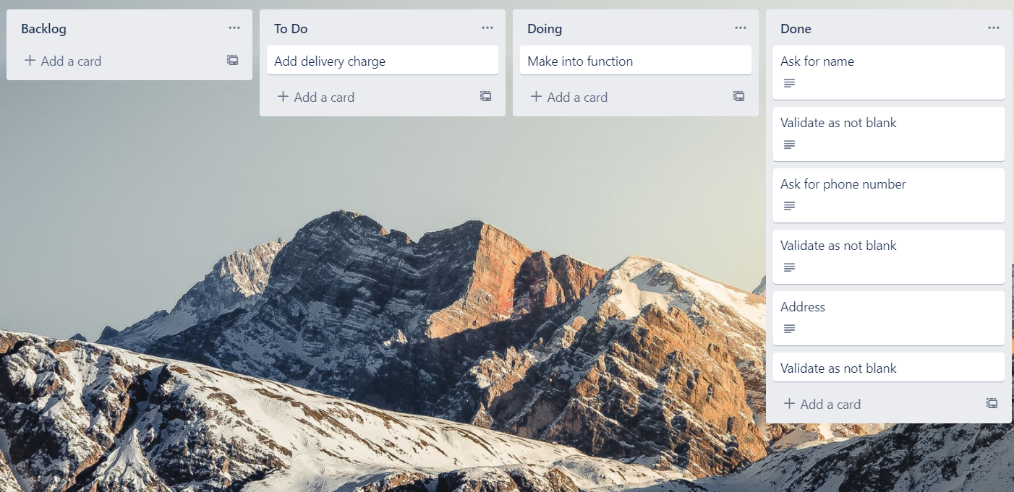
Component 4 delivery info v2 (Trello screenshot)

Slide 25
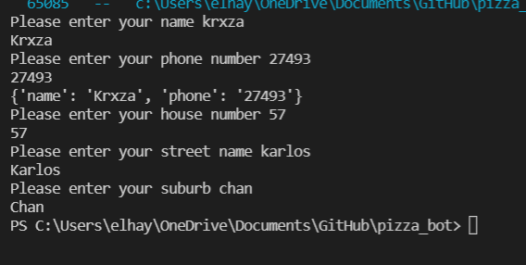
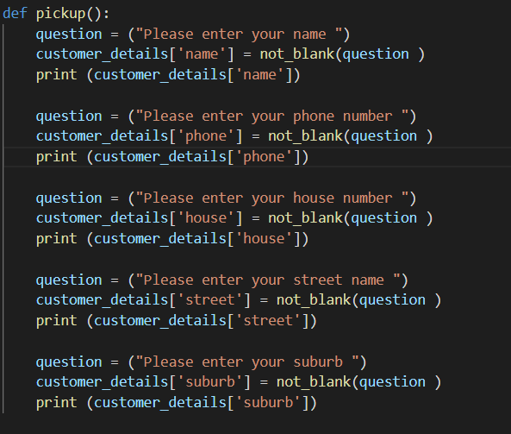
Component 4 v2 - Test Plan (?and screenshot)
Test Case | Expected Values
Input name Input phone number Input house number Street name Suburb name Left input blank | Printed name correctly Printed phone number Printed house number Printed street name Printed suburb name Asked for input again

Slide 26
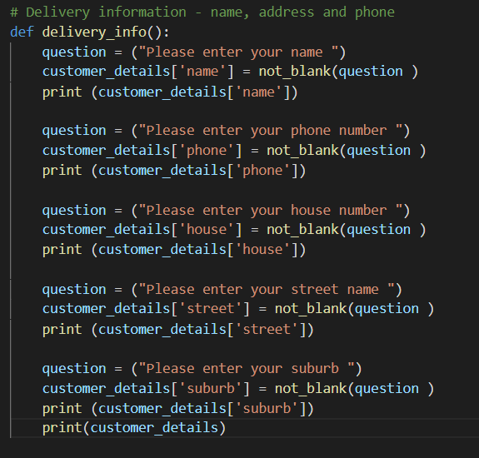
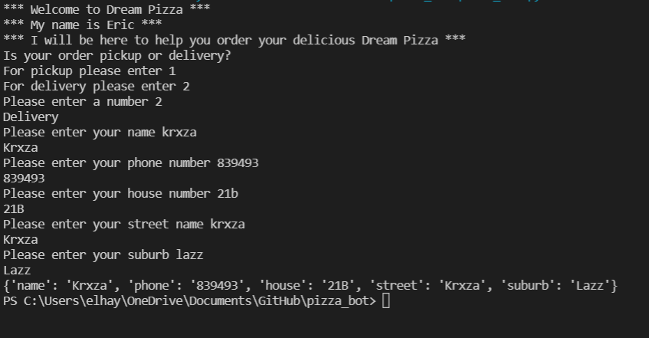
Component 4 v3 - Test Plan (?and screenshot)
Test Case | Expected Values
Input name Input phone number Input house number Street name Suburb name Left input blank | Printed name correctly Printed phone number Printed house number Printed street name Printed suburb name Asked for input again

Slide 27
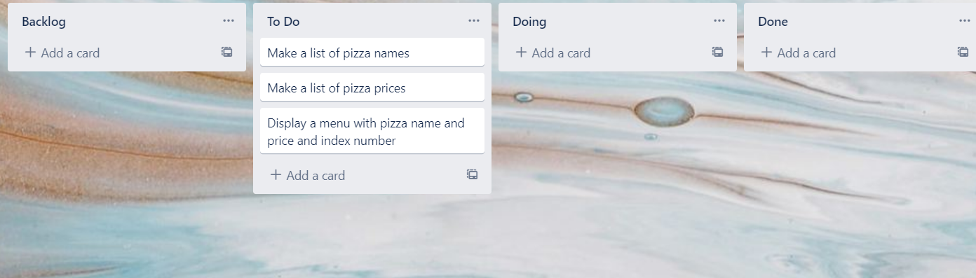
Component 5 Pizza Menu V1 (Trello screenshot)

Slide 28
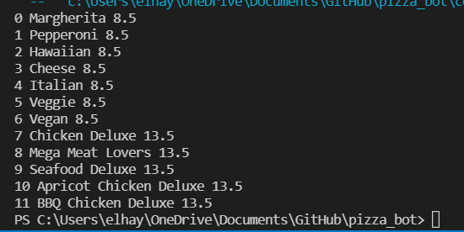
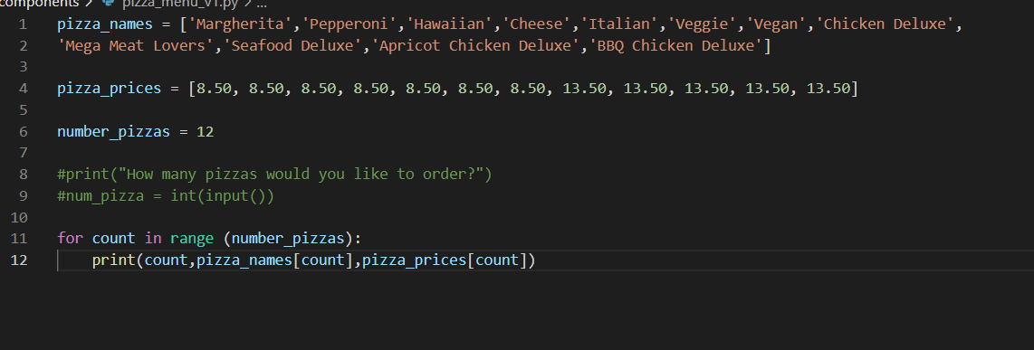
Component 5 v1 – Pizza menu (?and screenshot)
Test Case | Expected Values
Run file | Printed a list with index number, pizzas and prices

Slide 29
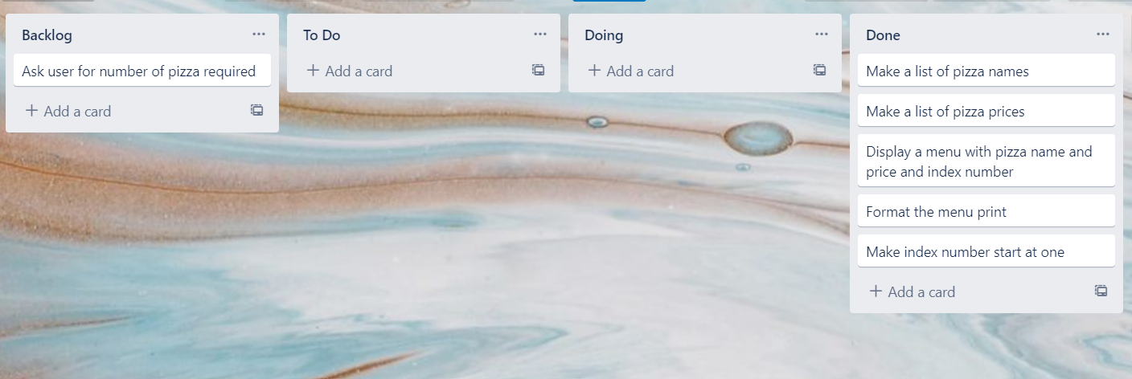
Component 5 Pizza Menu V2 (Trello screenshot)

Slide 30
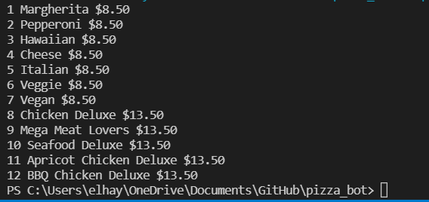
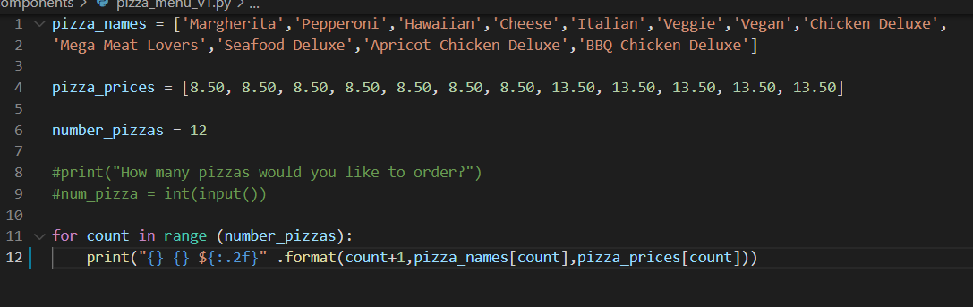
Component 5 v2 – Pizza menu (?and screenshot)
Test Case | Expected Values
Run file | Printed a list with index number, pizzas and prices with price formatted to 2 decimal places and dollar sign. Menu starts at 1.

Slide 31
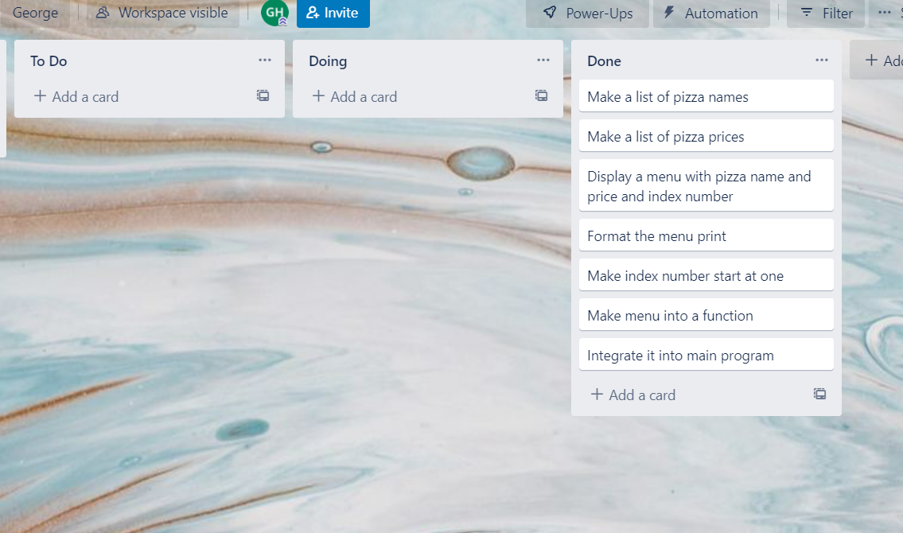
Component 5 Pizza Menu V3 (Trello screenshot)

Slide 32
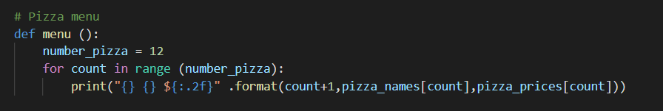
Component 5 v3 – Pizza menu integrated into main program
Test Case | Expected Values
Run file | Printed a list with index number, pizzas and prices with price formatted to 2 decimal places and dollar sign. Menu starts at 1.

Slide 33
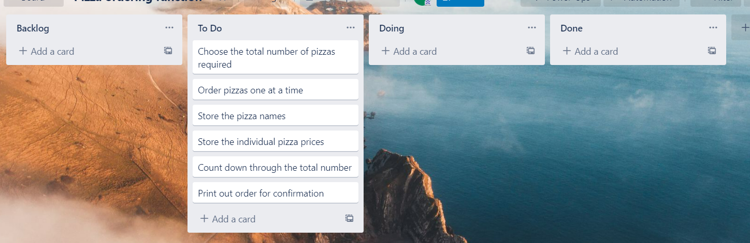
Component 6 Pizza Order V1 (Trello screenshot)

Slide 34
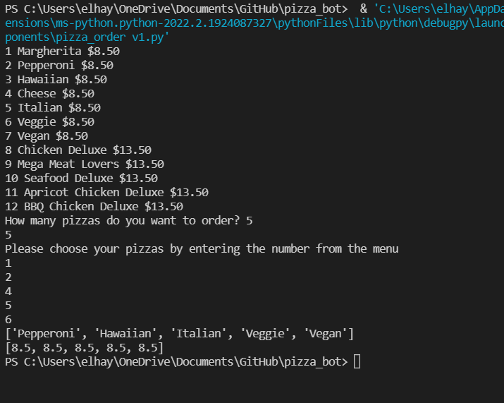
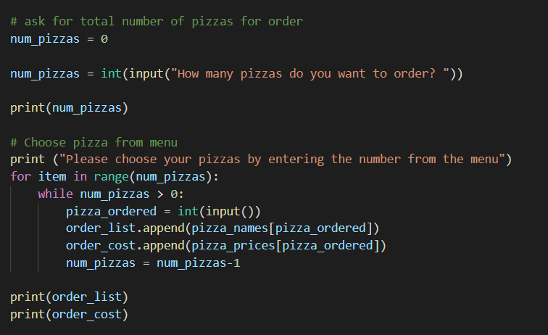

Component 6 Pizza Order v1
Test Case | Expected Values
Entered 5 pizzas Entered cat | Stepped through the menu choice 5 times. Program Broke

Slide 35
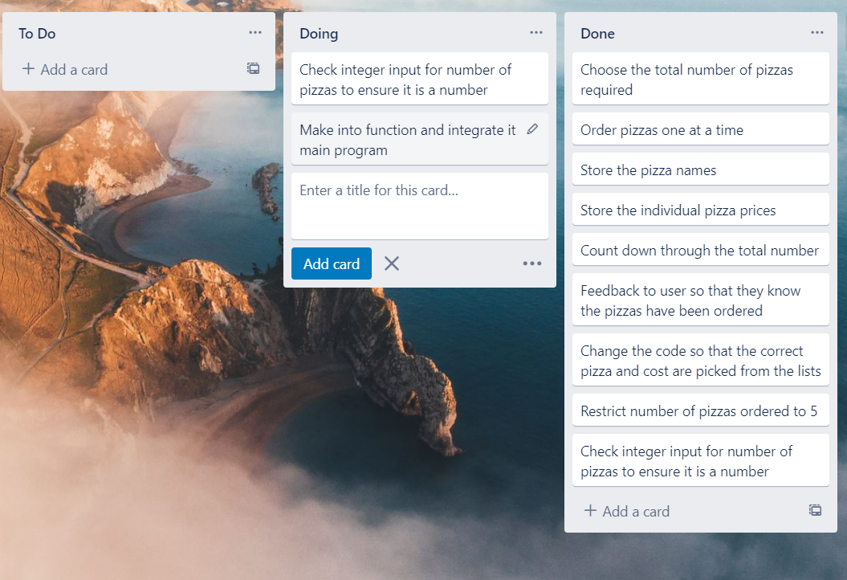
Component 6 Pizza Order V2 (Trello screenshot)

Slide 36
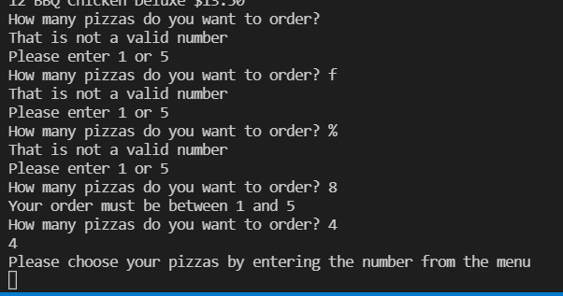
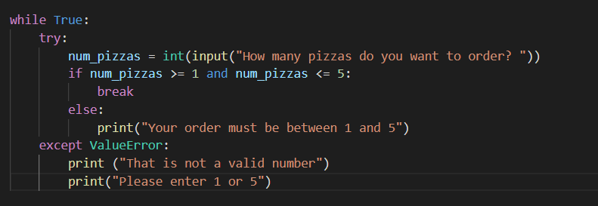
Component 6 Pizza Order v2
Test Case | Expected Values
f % Space 8 4 | Not a valid number Not a valid number Not a valid number Your order must be between 1 and 5 Accepted continues to order

Slide 37
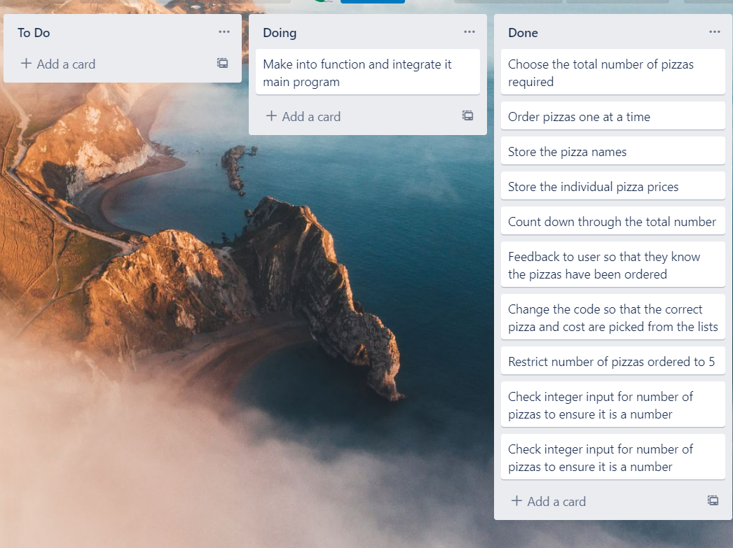
Component 6 Pizza Order V3 (Trello screenshot)

Slide 38


Component 6 Pizza Order v3
Test Case – Picking pizza number from menu | Expected Values
f % Space 8 4 | Not a valid number Not a valid number Not a valid number Your order must be between 1 and 5 Accepted continues to order

Slide 39
Version Control Evidence
Your version control evidence should go here. This could be in the form of annotated screenshots which show you you managed this process or you could make a brief screencast explaining how you implemented version control.
Notes:
Your version control evidence should go here. This could be in the form of annotated screenshots which show you you managed this process or you could make a brief screencast explaining how you implemented version control.

Slide 40
Discusses how the information from planning, testing and trialling of components assisted in the development of a high-quality outcome
Notes:
Discusses how the information from planning, testing and trialling of components assisted in the development of a high-quality outcome

